Slide 1
LIBRARY MANAGEMENT SYSTEM
Presented By
Mohammed Hassan Allahham
Abdus Sobhan Seikh
Presented To
Mr. Hani Abu Sharkh

Slide 2
Introduction
The project library management system is a software for monitoring and controlling the transaction in a library.
The project library management system is developed in c++, which mainly focused on basic operations in a library like adding new member, new books and updating new information, searching books and members to borrow and return the books.

Slide 3
Objectives Of The System
Possible outcome will bring simplicity and efficient transaction to achieve bellow mention objectives
Assistance to improve the library services.
To achieve the efficient statistics anytime for different purposes, which helps to analysis, control, quick decision making and visualization the information.
Avoid the need to hire additional staff with increased demand for services.
Help the librarian in reporting on the various operations of the library.

Slide 4
Problem Statement
Many libraries are operated manually by a group of people. These people keep records regarding the books & students (borrowers), check the books manually and keep records on issued books. All these things have to be carried out manually and if the library is very large, proper record keeping will become a major problem as manual record keeping has never been a reliable method because people tend to forget things.
Other problems of the existing system are:
Fast report generation is not possible
Tracing a book is difficult
Information about issue/return of the books is not properly maintained

Slide 5
ACCESS RIGHTS FOR DIFFERENT ACTORS
 | Member_Events | Book_Events | Member | Book
Library Staff | Read/Write | Read/Write | Read/Write | Read/Write
User | Read/Write | Read/Write | Read | Read
Supplier | Read/Write | Read/Write | Read | Read

Slide 6
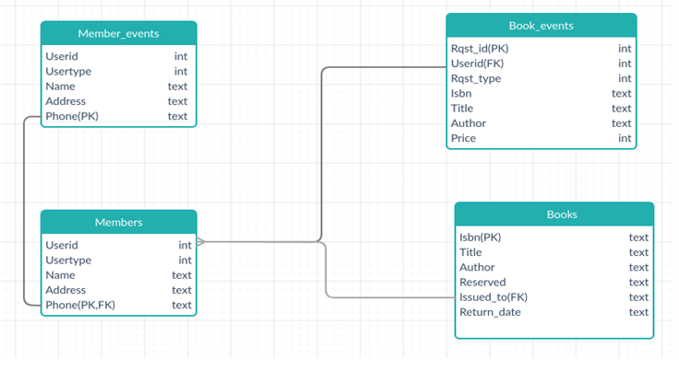
Database Architecture

Slide 7
Database Relationship
Users/Suppliers requests for membership are placed in Member_Events table where a unique UserId is issued to users.
Library staff adds new members to the library system in the Members table based on applications of memberships.
Suppliers provide quotations to sell the book and that information is stored in Book_Events.
In addition to quotation requests, requests regarding borrow and return of books are also placed in Book_Events.
Library staff can add books to the Books table providing details isbn, title, author, reserved status etc.
The information regarding successful issuance and return of book is also maintained by library staff in the Books table.

Slide 8
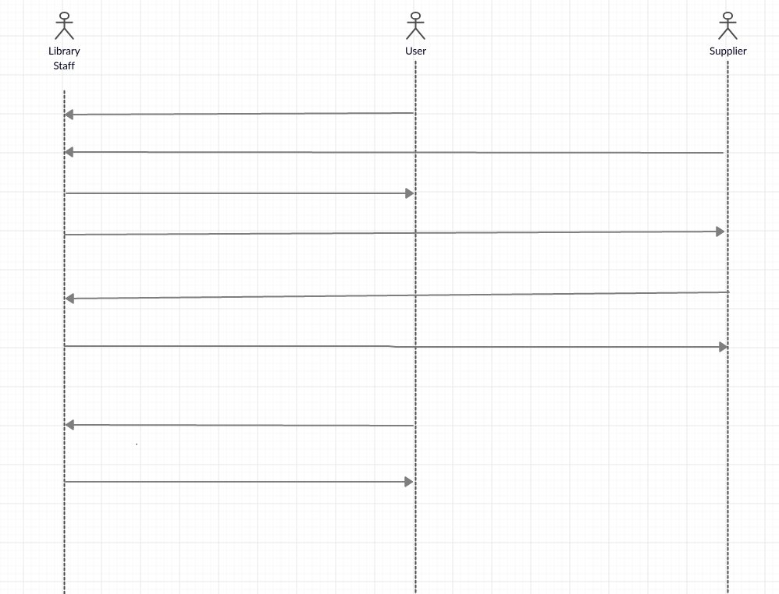
Sequence diagram
Sequence Diagram
Apply for membership with user details.
Apply for membership with supplier details.
Validate request and add user member.
Validate request and add supplier member.
Place a request to sell book.
Accept sell request and add book to library.
Request to borrow/return book.
Validate and accept requests to lend/return book.

Slide 9
Sequence Diagram
Users apply for the membership in the form of studen/teacher.
Library staff validates and adds a member to the library system.
Suppliers apply for membership providing details.
Library staff validates and adds suppliers as members.
Supplier places a request to sell a book with details of the book such as title, author, price etc.
Library staff look at the quotations and proceed to add the books.
Users request to borrow/return a book by providing its ISBN.
Library staff validates and lend/get returned books from the users.

Slide 10
Hardware and Software configuration
Hardware :
PC or Laptop with
i3 processor, 500 GB HD, and 4 GB Ram minimum.
Software:
Windows 10 operating system
CodeBlock IDE as C++ console
Sqlite3 for database
Microsoft Office PowerPoint for presentation

Slide 11
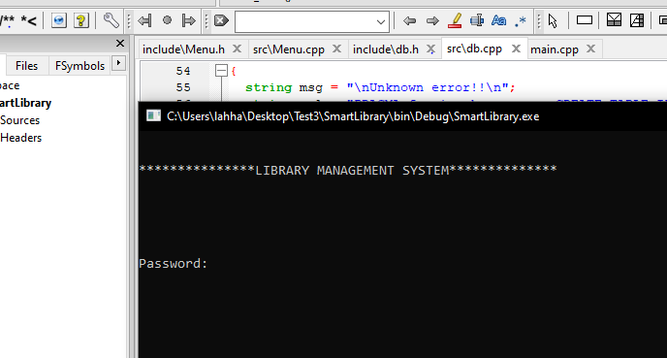
Login Prompt

Slide 12
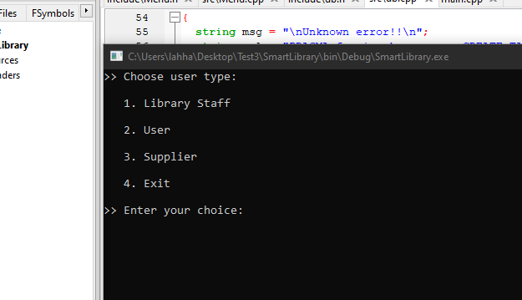
Prompt for USERTYPE

Slide 13
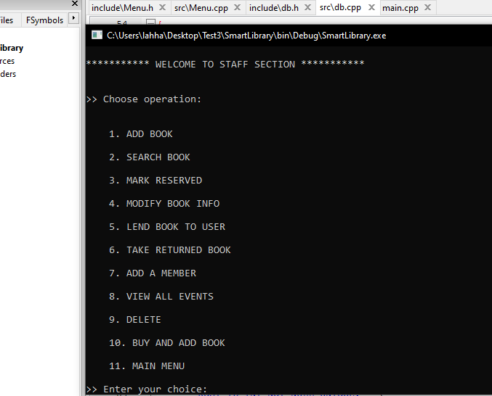
USERTYPE 1: Library Staff Operations

Slide 14
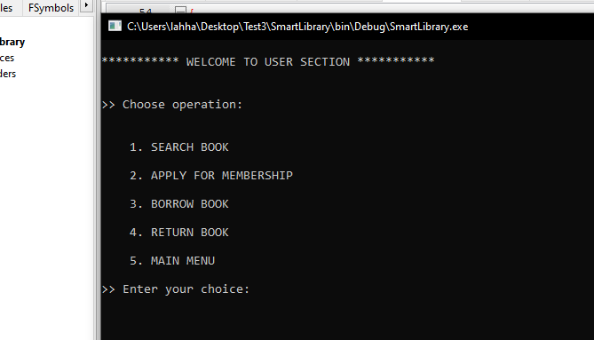
USERTYPE 2: User Operations

Slide 15
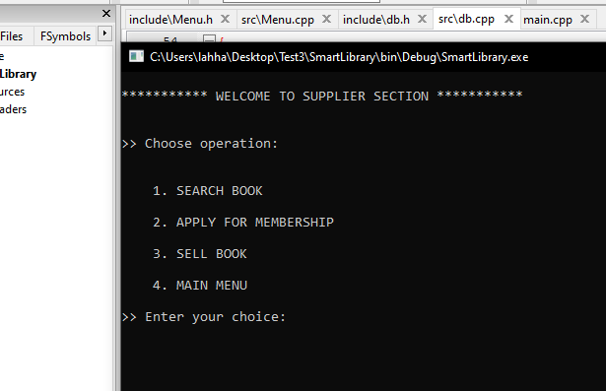
USERTYPE 3: Supplier Operations

Slide 16
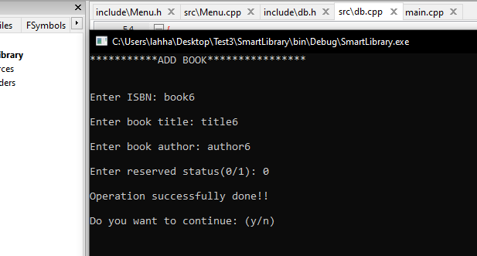
Add Book Operation

Slide 17
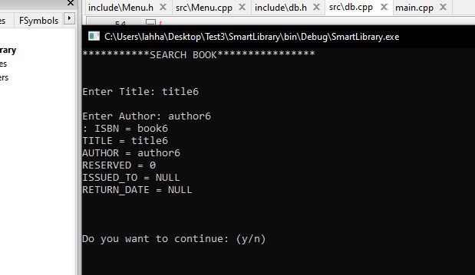
Search Book Operation

Slide 18
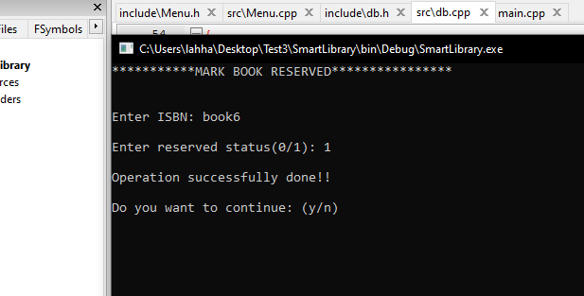
Mark Reserved Operation

Slide 19
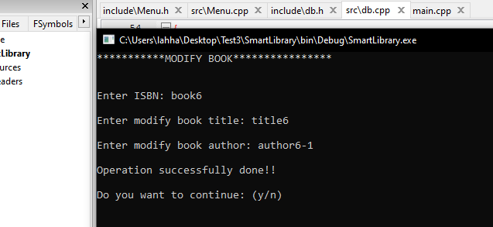
Modify Book Operation

Slide 20
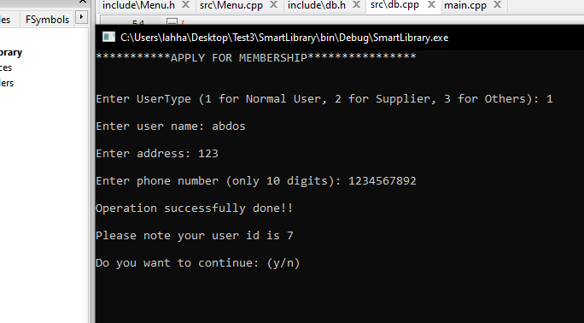
APPLY FOR MEMBERSHIP Operation

Slide 21
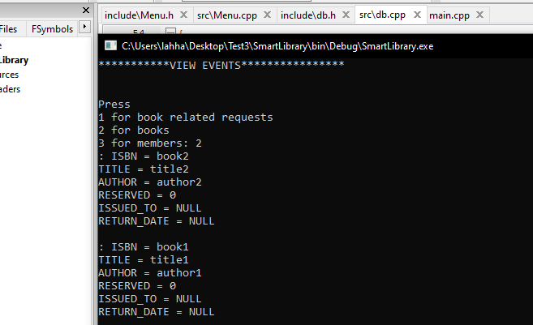
View Events Operation

Slide 22
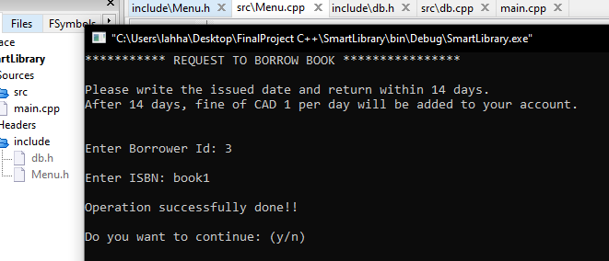
Borrow Book Operation

Slide 23
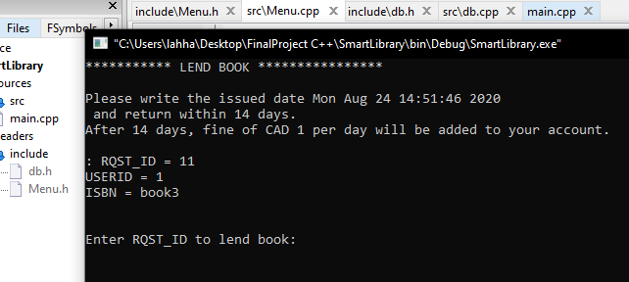
Lend Book Operation

Slide 24
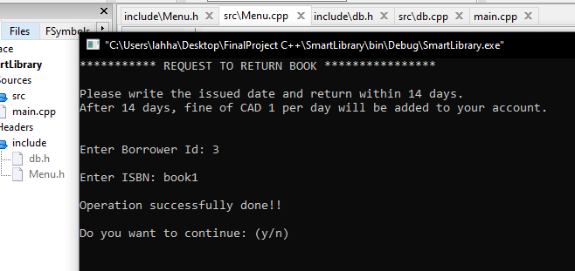
Return Book Operation

Slide 25
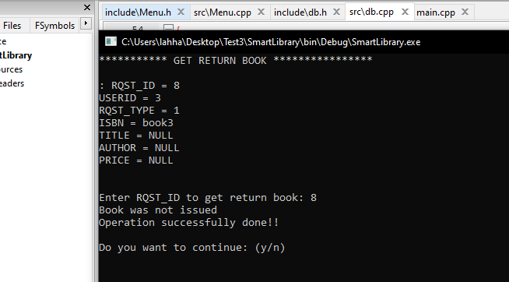
Get Return Book Operation

Slide 26
Sell Book Operation

Slide 27
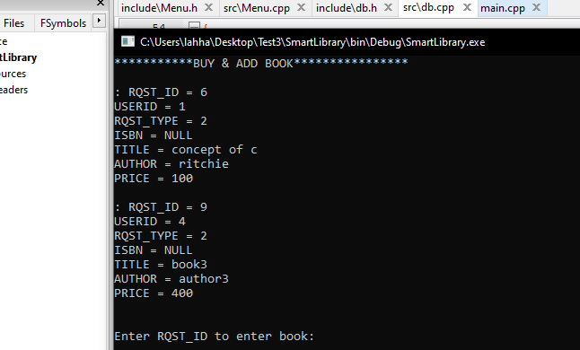
Buy & add Book Operation

Slide 28
Future Recommend Upgradations
Daily auto-backup configuration will save the system from certain data loose circumstances.
Addition accounting department which will track the earnings from borrower’s late submission fees. And utilize those balance for buying new books.
Block those users, who are paid late fees more than three times or those are 30 days late to submit the books.
Create help tools to user with operation instructions for each tools.

